Slide 1
CELL MEMBRANE
Dr.T.S.Asta Eshwaran
Dept. of Physiology
SKHMC, Kulasekharam

Slide 2
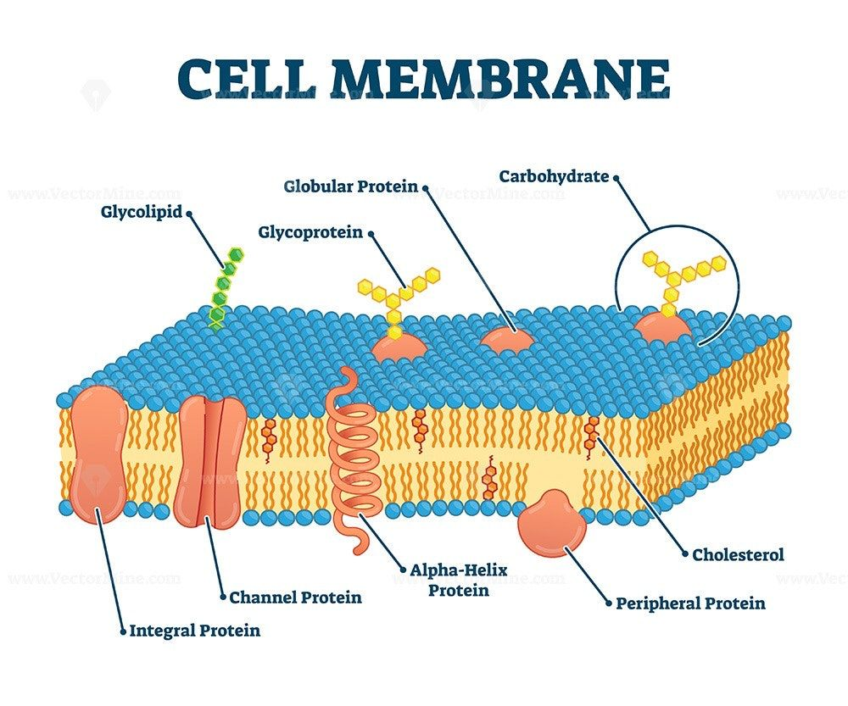

Slide 3
CELL MEMBRANE
Also called as Plasma membrane or Plasmalemma.
Protective sheath, enveloping the cell body.
Thickness varies from 6- 10 nm.
It is semipermeable in nature.

Slide 4
Composition
Proteins(55%)
Lipids(40%)
Carbohydrates(5%)

Slide 5
STRUCTURE OF CELL MEMBRANE
Two electron-dense layer:
Protein
One electron-lucent layer:
Lipid

Slide 6
LIPID LAYER
Central bilayered structure
Thin film of lipids
Fluid in nature, so it can move one point to another point.
Substance dissolved in lipid layer is
Phospholipids and Cholesterol

Slide 7
Phospholipids
It contains phosphorus and fatty acids.
Phospholipids molecules are arranged in 2 layers.
Each phospholipids molecules resembles the headed pin in shape.
The head part is the polar end and it is soluble in water and strong affinity for water (Hydrophilic) and tail part is insoluble in water and repelled by water(Hydrophobic).

Slide 8
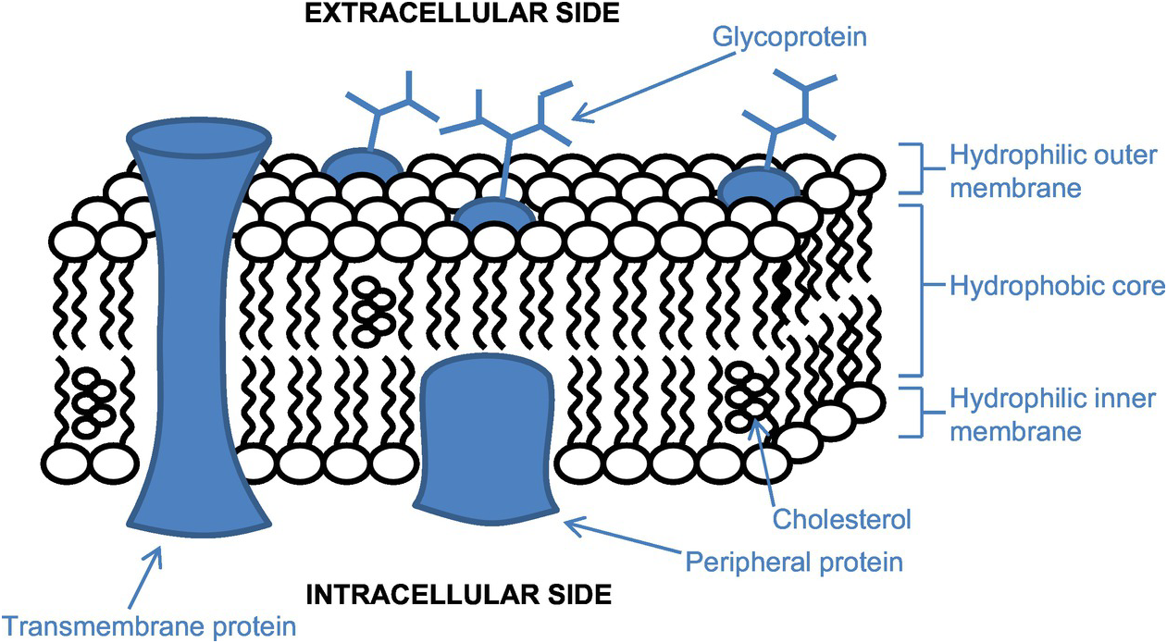

Slide 9
The two phospholipids are arranged in a way that tail parts meets in the centre.
Cholesterol
It arranged in between the phospholipid molecule, helps to pack the phospholipids.
So it is responsible for structure integrity.
Functions of Lipid Layer
Allows only fat soluble substance, oxygen, carbon-di oxide, alcohol.
Glucose, urea and electrolytes can’t.

Slide 10
PROTEIN LAYER
Electron- dense layer
It give protection to the middle lipid layer.
Glycoprotein
Protein molecule is divided into 2 categories
1. Integral proteins or trans membrane protein or intrinsic protein
2. Peripheral proteins or peripheral membrane protein.

Slide 11
Integral Proteins.
It cover the entire thickness of the cell membrane. These proteins are tightly bound with the cell membrane.
Cell adhesion proteins
Cell junction proteins
Carrier proteins
Channel proteins
Hormone receptors
Antigens
Enzymes

Slide 12
Peripheral proteins or Extrinsic protein
Partially embedded in the outer and inner surface of the cell membrane and do not penetrate the cell membrane.
2 types
Intercellular Peripheral Proteins. Which located on inner surface of cell membrane. Ex. Receptors, transport proteins and enzymes.
Extracellular Peripheral Proteins.
Ex. Antigens, adhesion proteins and enzymes.

Slide 13
Functions of Proteins in cell membrane
Integral proteins provide structural integrity of cell membrane.
Channel protein helps in diffusion of water soluble substance such as glucose and electrolytes.
Carrier proteins helps in transport by active and passive transport.
Also acts as pumps, by which ions are transported actively.

Slide 14
Receptor protein serve as receptor sites for hormones and neurotransmitters.
Enzymes: Control Chemical reaction within the cell membrane.
Antigens: Induce the process of antibody formation.
Cell adhesion molecules or the integral proteins are responsible for attachment of cell to their neighbors cells or to basal lamina.

Slide 15
Carbohydrates
It is thin and loose covers the entire surface of the cell membrane called glycocalyx.
Carbohydrate molecules attached to protein and form glycoproteins(Proteoglycans).
Carbohydrate molecules attached to lipids and form glycolipids

Slide 16
Functions of carbohydrates in Cell membrane
Negatively charged and do not permit the negatively charged substance.
Glycocalyx from the neighboring cells in help in tight fixation of cells with one another.
Receptors for some hormones.

Slide 17
Functions of Cell Membrane
Protective function: Cytoplasm and the organelles
Selective permeability: Allow only some substance
Absorptive function: Absorption of nutrition.
Excretory function: Metabolites and other waste products.

Slide 18
Exchange of gases: Oxygen and Carbon dioxide
Maintenance of shape and size of the cell

Slide 19
CELL JUNCTIONS

Slide 20
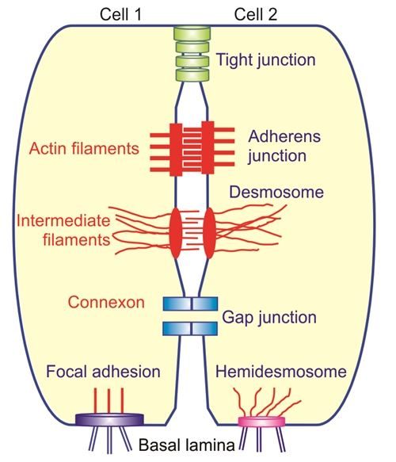

Slide 21
CELL JUNCTIONS
It is the connection between neighboring cells or the contact between the cell and extracellular matrix. It is also called as membrane junction.
Connection between 2 cells is Intercellular junction

Slide 22
Cell junctions are classified into 3 types
1. Occluding junctions
2. communicating junctions
3. Anchoring Junctions
OCCLUDING JUNCTION
Cell junction which prevent intercellular exchange of substance are called occluding junction.
No movement of ions and molecules from one cell to another cell
Eg. Tight junction

Slide 23
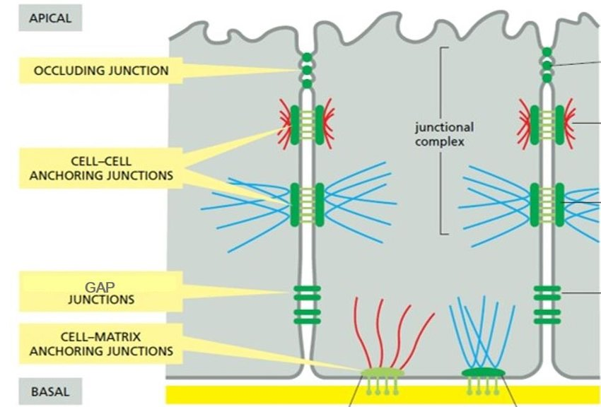

Slide 24
Tight Junction
Intercellular occluding junction that prevents the passage of large molecules. It is called Zonula occludents.
Cell membrane of the adjacent cells fuse firmly.
Present in apical margins of epithelial and endothelial cells in intestinal mucosa, wall of renal tubule, capillary wall and choroid plexus.

Slide 25
Structure
Made up of ridge which has 2 halves.
Both halves of the ridge fuse with each other very tightly and occupy the space between the 2 cells. Each half of the ridge consists of tight junction strands.
Protein of tight junctions
1. Tight junction membrane proteins or integral membrane proteins such as occludin, claudin & junctional adhesions molecules(JAMs)

Slide 26
2. Scaffold proteins or peripheral membrane proteins or cytoplasmic plague proteins such as Cingulin, symplekin and Zo-1,2,3.
Functions of Tight Junctions
1. Strength and stability: Holds the neighboring cells of the tissue firmly.
2. Selective Permeability: it forms a selective barrier for small molecules and total barrier for large molecules.

Slide 27
3. Fencing function: Prevent then lateral movement of proteins and lipids in cell membrane.
4. Maintenance of cell polarity: Fencing junction maintain the cell polarity by keeping the proteins in the apical region of the cell membrane.
5. Blood Brain barrier(BBB): Brain capillaries forms the blood brain barrier, which prevents the entrance of substance from capillary blood into brain tissues. Only lipid- soluble substance.

Slide 28
Applied Physiology.
Occur due to mutation of genes encoding proteins of tight junction.
Hereditary deafness
Ichthysosis
Sclerosing cholangitis.
Hereditary Hypomagnesemia.
Synovial sarcoma.

Slide 29
COMMUNICATING JUNCTIONS
Cell junctions which permits the intercellular exchange of substance are communication junctions.
e.g. Gap junction and Chemical synapse.
Gap Junctions
Allows passage of ions and smaller molecules between the cells. It is called nexus.

Slide 30
Structure
Cell membrane of the 2 adjacent cells lie very close to each & the intercellular space is reduced from the usual size of 2.5 to 3 nm.
Cytoplasm of the 2 cells is connected by the channels formed by the membrane of both cells, so molecules from both cells move from one cell to another without contact of extracellular fluid.

Slide 31
Functions
Diameter of the channel in the gap is about 1.5 to 3nm. So the channel permits glucose, aminoacids, ions and other substances.
Helps in the exchange of chemical messengers between the cell .
Helps in rapid propagation of action potential from one cell to another cell.

Slide 32
Regulation of the diameter of the channels in gap junction
Each channel is regulated by the intracellular calcium ions. If the intracellular calcium ion is increased, the protein subunits of connexin surroundes the channel come close to each other by sliding.

Slide 33
Chemical synapse
It is the junction between a nerve fiber and a muscle fiber of between 2 nerve fibers through with the signals are transmitted by the release of chemical transmitters.
Applied Physiology
Deafness, Keratoderma, cataract, Peripheral neuropathy, Charcot-Marie-Tooth disease, Heterotaxia

Slide 34
ANCHORING JUNCTIONS
Junctions that provides strength to the cells by acting like mechanical attachments.
These junctions provide firm attachments between the cells or between the extracellular matrix. Provided by either actin filaments or the intermediate filaments.

Slide 35
Actin Filament attachment
i. Adherens junction (cell to cell)
ii. Focal adhesion (cell to matrix)
Intermediate Filament
i. Desmosome (cell - cell)
ii. Hemidesmosome (cell to matrix)

Slide 36
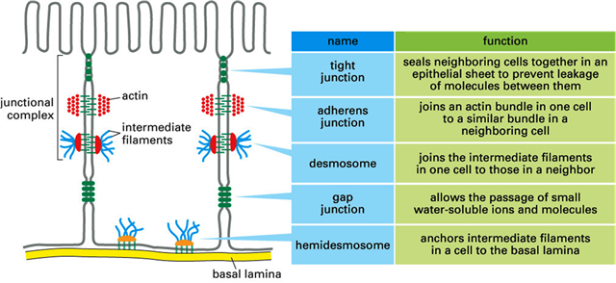

Slide 37
Adherens Junction
Which connects the actin filaments of one cell to another cell.
In epithelial linings, adherens junctions forms a continuous adhesion(Zonula adherens) just below the tight junctions.
Membranes of the adjacent cells are held together by some transmembrane proteins called cadherins.

Slide 38
Adherens Junctions Provide..
Strong mechanical attachments
Present in the intercalated disks between the branches of cardiac muscle fibers are held tightly during contraction and relaxation of heart.
In epidermis helps the skin to withstand the mechanical stress.

Slide 39
Focal adhesion
Connects cell to the extracellular matrix.
In epithelia of various organs, its connects the cells with their basal lamina.
The transmembrane proteins, which hold the cell membrane and the matrix are called intergins.

Slide 40
Desmosome
Cell to cell Junction
Also called as macula adherens.
The membrane of two adjacent cells are thickened and become spot-like patches.
These filaments are arranged in parallel and in radiating in nature.
It functions like tight junctions.
The transmembrane protein involved in desmosome are mainly cadherins.

Slide 41
Hemidesmosome
Cell to Matrix Junction
This type of junction looks like half desmosome and the thickening of membrane of only one cell occurs.
It connects the cells with their basal lamina. The proteins involved in this are integrins.

Slide 42
Applied Physiology
Adhesion and focal adhesion junction abnormality
Mutation of junction proteins(cadherins) in adherens junction and integrins in focal adhesion junction
Colon cancer
Tumor metastasis

Slide 43
Desmosome and Hemidesmosome abnormality
Mutation of junction proteins(cadherins) in desmosome and integrins in hemidesmosome.
Bullous pemphigus
Antibodies develop against cadherins in desmosomes and integrins in hemidesmosome.
Loosens the attachment between adjacent epithelial cells and produces blisters.

Slide 44
CELL ADHESION MOLECULES
Proteins present on the cell surface.
Responsible for the binding of cells to their neighbors or to basal lamina.
Forms the important structure of intercellular connections and are responsible for structural organization of tissue.
Types of Cell Adhesion Molecules(CAMs)
Cadherins: forms molecular limbs between neighboring cell. Adherens & Desmosome.

Slide 45
Integrins: Focal adhesion and hemidesmosome.
IgG super family: Cell adhesion molecules in nervous system.
Selections: act as receptors for carbohydrates (Ligand and mucin) and are found in platelets and endothelial cells.

Slide 46
Thank you

